Slide 1
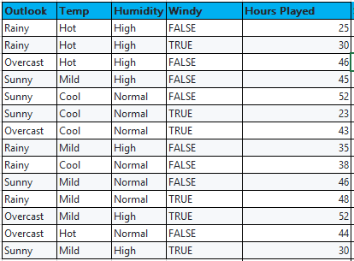
Input Attributes
(Categorical)
Target value
(Real Number)

Slide 2
Find “SD” of Target Variable
SD = Standard Deviation
SDR = Standard Deviation Reduction
Find “SD” of Each Input Attribute
Find “SDR” of Each Input Attribute (“SD” of target Variable – “SD” of Input Attribute)
Consider Input Attribute with Highest “SDR” as Root Element
Divide the dataset into Sub-Branches(Sub-Partitions)
If Threshold < 10%
Leaf Node
Yes
No
Threshold: Depends on Business use case
for our Example we considered 10%

Slide 3
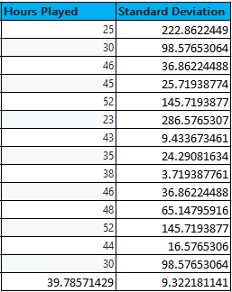
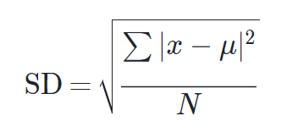
The formula for standard deviation (SD) is:
1
Standard deviation:
SD = 9.32
2

Slide 4
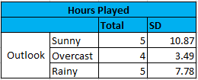
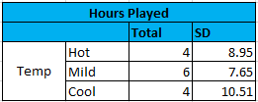


SD(Hours, Outlook) = P(Overcast)*S(Overcast) + P(Rainy)*S(Rainy) + P(Sunny)*S(Sunny)
= (4/14) * 3.49 + (5/14) * 7.78 + (5/14) * 10.87
= 1.0 + 2.78 + 3.88
= 7.66
SD(Hours, Temp) = P(Hot)*S(Hot) + P(Mild)*S(Mild) + P(Cool)*S(Cool)
= (4/14) * 8.95 + (6/14) * 7.65 + (4/14) * 10.51
= 2.56 + 3.28 + 3.0
= 8.84
SD(Hours, Humidity) = P(High)*S(High) + P(Normal)*S(Normal)
= (7/14) * 9.36+ (7/14) * 8.37
= 4.68 + 4.19
= 8.865
SD(Hours, Windy) = P(TURE)*S(TRUE) + P(FALSE)*S(FALSE)
= (6/14) * 10.59 + (8/14) * 7.87
= 4.54 + 4.5
= 9.03

Slide 5

Standard deviation Reduction:
SDR(Hours, Outlook) = SD(Hours Played) – SD(Outlook)
= 9.32 – 7.66
= 1.66
SDR(Hours, Temp) = SD(Hours Played) – SD(Temp)
= 9.32 – 8.84
= 0.48
SDR(Hours, Humidity) = SD(Hours Played) – SD(Temp)
= 9.32 – 8.86
= 0.46
SDR(Hours, Windy) = SD(Hours Played) – SD(Temp)
= 9.32 – 9.03
= 0.29

Slide 6
Outlook
Sunny
Overcast
Rainy
Outlook
Sunny
Overcast
Rainy

Slide 7


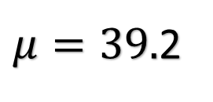
Outlook | Temp | Humidity | Windy | Play Golf
Overcast | Hot | High | FALSE | 46
Overcast | Cool | Normal | TRUE | 43
Overcast | Mild | High | TRUE | 52
Overcast | Hot | Normal | FALSE | 44
Group – 1
$$μ=46.3$$
Rainy | Hot | High | FALSE | 25
Rainy | Hot | High | TRUE | 30
Rainy | Mild | High | FALSE | 35
Rainy | Cool | Normal | FALSE | 38
Rainy | Mild | Normal | TRUE | 48
Group – 2
$$μ=35.2$$
Sunny | Mild | High | FALSE | 45
Sunny | Cool | Normal | FALSE | 52
Sunny | Cool | Normal | TRUE | 23
Sunny | Mild | Normal | FALSE | 46
Sunny | Mild | High | TRUE | 30
Group – 3
$μ=39.$2

Slide 8
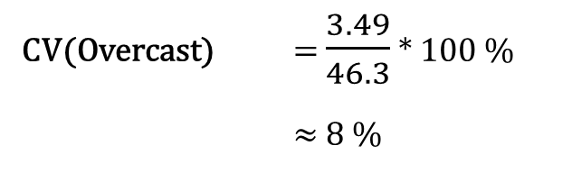
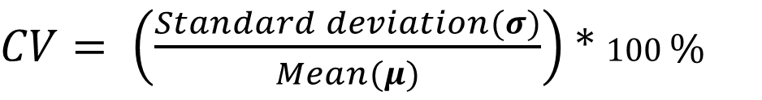
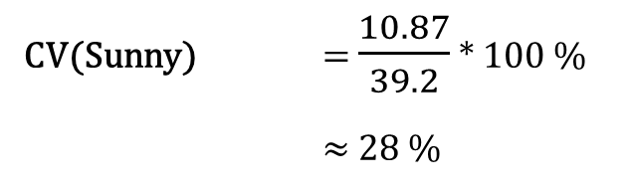
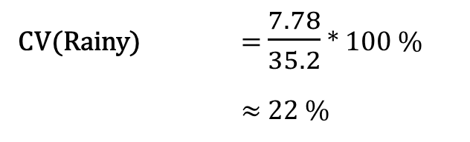
Coefficient of Variation:
$CV= \left(\frac{Standard deviation(σ)}{Mean(μ)}\right)$ * 100 %
CV(Overcast) = $\frac{3.49}{46.3}$ * 100 %
$≈$ 8 %
CV(Rainy) = $\frac{7.78}{35.2}$ * 100 %
$≈$ 22 %
CV(Sunny) = $\frac{10.87}{39.2}$ * 100 %
$≈$ 28 %

Slide 9
Outlook
Root Node
Sub-Partition
Sunny
Overcast
Rainy
46.3
Windy
Temp
FALSE
TRUE
Cool
Hot
Mild
47.7
26.5
38
27.5
41.5

